Slide 1

TRACKTREK
TEAM CHARMANDER
Brian
Elianice
Jackson
Sean
Shane
Presents the Web Application:
CREATE A PLAYLIST AND ENJOY YOUR TRIP

Slide 2
THE CONCEPT
TRACKTREK
This Web Application was created for entertainment.
At the very beginning, as MVP, the concept was to create a funny and inovative way to use music as a new metric to answer the question: “how many a specific music is the distance between 2 points (cities, spots, places, etc.)?” So, the answer would be like:
“The distance between Minneapolis and Chicago is 84 ‘My Way’ by Frank Sinatra”.
With the IVP, the original concept changed for a more complex web application, where the user could build a playlist based on his favorite artists, and in accordance with the time of the trip.
But, the initial funny part was maintained!

Slide 3
THE motivation
TRACKTREK
The motivation for this Project was:
During the building process, transform a idea pretty simple in a Web App more intuitive and useful for the user (client).
technologies
HTML
CSS – MATERIALIZE
JAVASCRIPT
Axios
localForage (database)

Slide 4
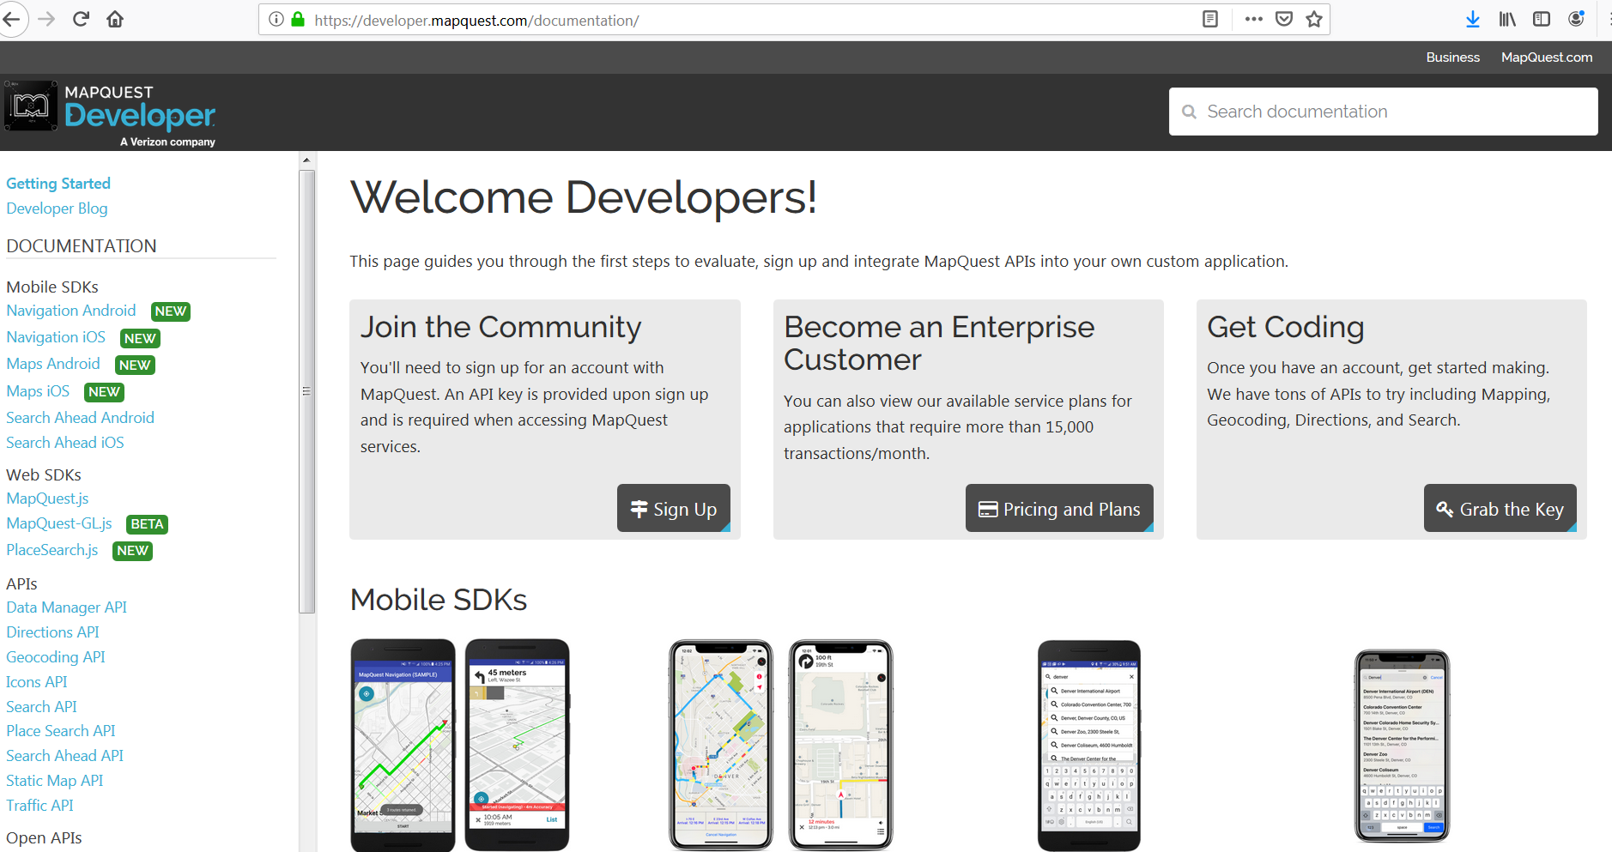
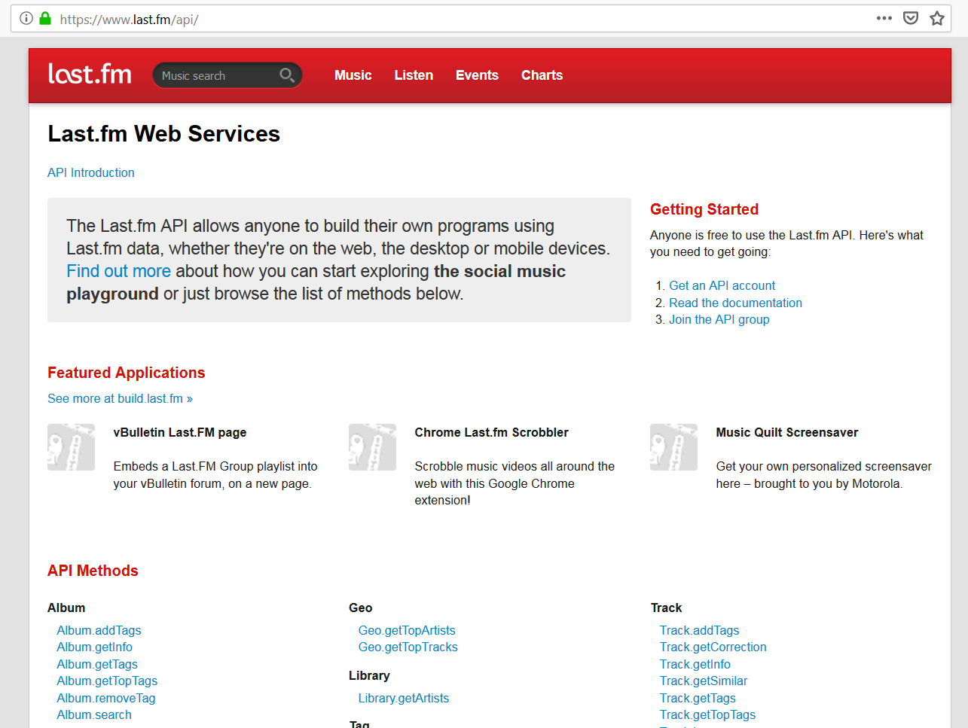
THE API’s
TRACKTREK
https://www.mapquestapi.com
https://ws.audioscrobbler.com
(https://www.last.fm/api/)
Initial City & State
Final City & State
Distance (miles, km)
Time for distance (minutes)
Artist
Album
Tracks
Duration (milliseconds)

Slide 5
THE design process
TRACKTREK
Definition of the MVP
Definition of the IVP
Create the HTML & CSS bases – using Materialize as alternative CSS framework
Create the URL requests – using Axios as third part of Javascript
Implement a localForage (persistent data storage) for the playlist and trip time
Validation of the user inputs
Implement UI/UX
Tests and validation – bugs, responsiveness, usability by user
Deployment on GitHub

Slide 6
demonstration
TRACKTREK
Link for the deployed page on Github

Slide 7
next steps the future of the web application
TRACKTREK
As part of the IVP, the Web App can be improved by:
Play the playlist created by the user
Insert the control buttons for the playlist
Add a button for every track on the playlist to select the favorite tracks
Expand the cities & states to places outside of United States

